Slide 1
Advanced Data Management – Week 2
Distributed Systems: Problems, Failures and Availability in Databases

Slide 2
The Problem Is the Model and the Architecture
The limitations arise from:
The relational model with strong dependence on joins
The assumption of centralized control and strong consistency
The scale-up architecture as the default
When the model and architecture are transferred to large-scale distributed environments, performance, availability, and complexity issues emerge.

Slide 3
RDBMS Were Not Designed for Cloud-Native Environments
Traditional RDBMS:
Were designed for on-premise infrastructures
Assume reliable networks and stable hardware
Rely on strong consistency and synchronization
In contrast, cloud-native environments require:
Distributed operation from the outset
Fault tolerance
Elastic scalability
Automation
This incompatibility explains why new data models and architectures were developed.
Notes:
On-premise = local physical property

Slide 4
The Problem Is NOT SQL – Conclusion
The transition to NoSQL and Big Data is not a rejection of SQL, but a recognition that the traditional relational model and monolithic RDBMS architecture are insufficient for cloud-native, large-scale distributed systems.

Slide 5
Fundamental Principles of Distributed Systems

Slide 6
What Is a Distributed System
A distributed system is a set of autonomous computational nodes that:
Communicate over a network
Cooperate to achieve a common goal
Appear to the user as a single unified system
Each node has:
Its own memory
Its own processor
Potentially its own storage
Notes:
Why Google Search is a Distributed System
Google Search is not a single computer. It is composed of:
Thousands (actually millions) of servers
Distributed across multiple data centers worldwide
Working together as one unified system
To the user, it appears as a single search engine.
In reality, it is a massive distributed system.
Google Search:
✔ Has autonomous servers ✔ Communicates via network ✔ Handles failures automatically ✔ Appears as one unified service
Core Distributed Characteristics
1️⃣ Data Partitioning (Sharding)
The web index is divided into parts and stored across different machines.
2️⃣ Replication
Each piece of data is stored in multiple locations:
Fault tolerance
High availability
3️⃣ Fault Tolerance
If one server fails:
Another replica serves the request
The user never notices
4️⃣ Horizontal Scalability
Google scales by:
Adding more machines (scale-out)
Not by upgrading a single machine
5️⃣ No Global Clock
Servers operate independently and coordinate through protocols.

Slide 7
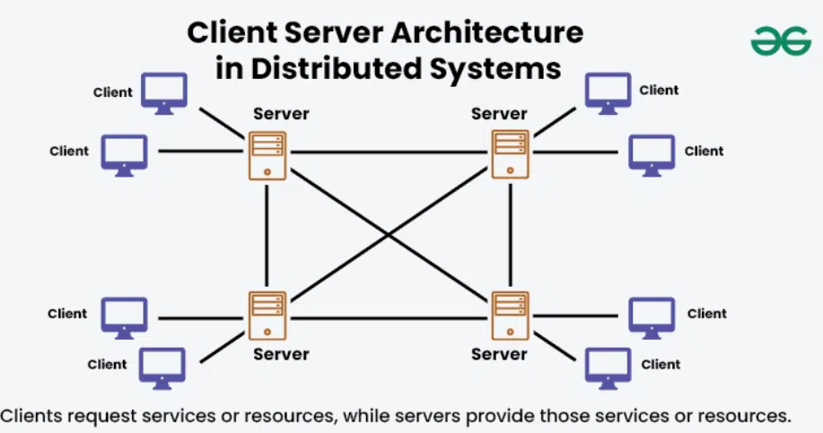
A Distributed System
Notes:
Best Example to Explain in Class
If you want something students understand instantly:
👉 Instagram
Users = nodes in a graph
Posts stored distributed
Likes and follows replicated
Always available
Fault tolerant

Slide 8
Why Do We Need Distributed Systems
The use of distributed systems is driven by:
The need for horizontal scalability
Management of large volumes of data
Requirement for high availability
Geographic distribution of users and services
Modern NoSQL systems cannot exist without distributed architecture.

Slide 9
Basic Assumptions
In a distributed system:
The network is not reliable
Nodes can fail
Latency is not zero
There is no global clock
These assumptions are fundamental and determine every design decision.

Slide 10
Distribution Transparency
The goal of distributed systems is to hide:
The physical location of data
The number of nodes
Failures of individual nodes
The user or application should not know where the data are stored.

Slide 11
Scalability
Scalability is a fundamental characteristic:
Vertical (Scale-Up): stronger server
Horizontal (Scale-Out): more nodes
Distributed NoSQL systems are designed exclusively for scale-out.

Slide 12
Data Partitioning (Sharding)
Data are divided into segments (shards) and:
Stored on different nodes
Each shard serves part of the requests
Goal:
Reduce load per node
Enable parallel request handling

Slide 13
Data Replication
Each piece of data:
Is stored in multiple replicas
Across different nodes
Benefits:
Fault tolerance
High availability
Faster access
Cost:
Increased complexity in maintaining consistency

Slide 14
Fault Tolerance
The system must continue operating:
Even if one or more nodes fail
Without loss of critical data
Achieved through:
Replication
Recovery mechanisms
Automatic load redistribution
Notes:
Example: How a Distributed System Continues When Nodes Fail
Case: Netflix Using Cassandra
Scenario
Netflix stores user viewing history in a distributed database (Apache Cassandra).
Assume:
Data is replicated 3 times.
Each piece of data exists on 3 different nodes.
Example:
User 123 watch history is stored on:
Node A (USA)
Node B (Germany)
Node C (France)
This is called replication factor = 3.
💥 What Happens If One Node Collapses?
Step 1 — Node B crashes
Maybe:
Hardware failure
Power outage
Network partition
Node B becomes unavailable.
Step 2 — System Response
The system automatically:
✔ Detects node failure ✔ Stops sending traffic to Node B ✔ Routes requests to Node A or Node C
The user continues streaming normally.
No visible downtime.
🔁 How Is This Possible?
Because of:
1️⃣ Replication
Data exists in multiple copies.
If one copy fails → others exist.
2️⃣ Consistency Model
Cassandra can operate with:
Strong consistency (if needed)
Eventual consistency (default)
If one node is down:
Remaining nodes still respond
Data remains accessible
3️⃣ Automatic Recovery (Self-Healing)
When Node B comes back:
It automatically syncs missing updates
Replicas are repaired
Cluster returns to full redundancy
This is called anti-entropy repair.

Slide 15
State Consistency
When multiple replicas exist:
When and how are they synchronized?
What does the user observe?
Distributed systems cannot always guarantee immediate consistency. (This leads directly to the CAP Theorem.)
Notes:
🔬 Concrete Example with Numbers
Imagine:
Replication Factor = 3 Consistency Level = QUORUM
To read/write, the system needs 2 out of 3 nodes.
If 1 node fails:
Remaining nodes = 2 2 ≥ quorum
✔ System continues operating ✔ No service interruption
If 2 nodes fail:
Remaining nodes = 1 1 < quorum
❌ Strong consistency cannot be guaranteed But eventual consistency may still serve reads

Slide 16
Communication Between Nodes
Nodes communicate through:
Message passing
RPC / APIs
Asynchronous protocols
Communication:
Has latency
May fail
Is not always symmetric
Notes:
Remote Procedure Call (RPC) protocol is generally used to communicate between processes on different workstations
An API, or application programming interface, is a set of rules or protocols that enables software applications to communicate with each other to exchange data, features and functionality.

Slide 17
Coordination & Agreement
In many scenarios, systems require:
Agreement on system state
Leader election
Synchronization of actions
This is one of the most difficult problems in distributed systems.
Notes:
Example of Coordination & Agreement
Case: Leader Election in a Distributed Database (e.g., Raft in etcd / MongoDB / Kafka)
🎯 Scenario
You have a distributed system with 5 nodes:
Node A
Node B
Node C
Node D
Node E
One of them must act as the leader.
The leader is responsible for:
Accepting writes
Coordinating updates
Ensuring consistency
💥 What Happens If the Leader Crashes?
Suppose:
Node A is the leader.
Suddenly:
Node A crashes.
Now the system must:
1️⃣ Detect the failure
2️⃣ Elect a new leader
3️⃣ Ensure everyone agrees who the new leader is
This is coordination & agreement.
🔁 How Agreement Happens (Raft Example)
Step 1 — Failure Detection
Nodes notice:
They stop receiving heartbeats from Node A.
After a timeout:
Each node becomes a candidate.
Step 2 — Voting
Each candidate asks others:
“Vote for me as leader.”
Each node can vote only once.
Example:
Node B gets votes from C and D.
That is 3 out of 5.
Majority = 3
✔ Node B becomes new leader.
Step 3 — Agreement Achieved
All nodes now:
Accept Node B as leader.
Route writes through Node B.
System continues normally.
🔐 Why This Is Agreement
Agreement means:
All non-faulty nodes agree on the same value.
In this case:
The value = “Node B is leader”
If nodes disagree:
Two leaders may exist
Data inconsistency occurs
System breaks

Slide 18
Why All This Matters for NoSQL
NoSQL databases:
Are inherently distributed
Rely on partitioning and replication
Operate under network uncertainty
Without understanding distributed systems, proper NoSQL design is impossible.

Slide 19
Birth & Philosophy of NoSQL

Slide 20
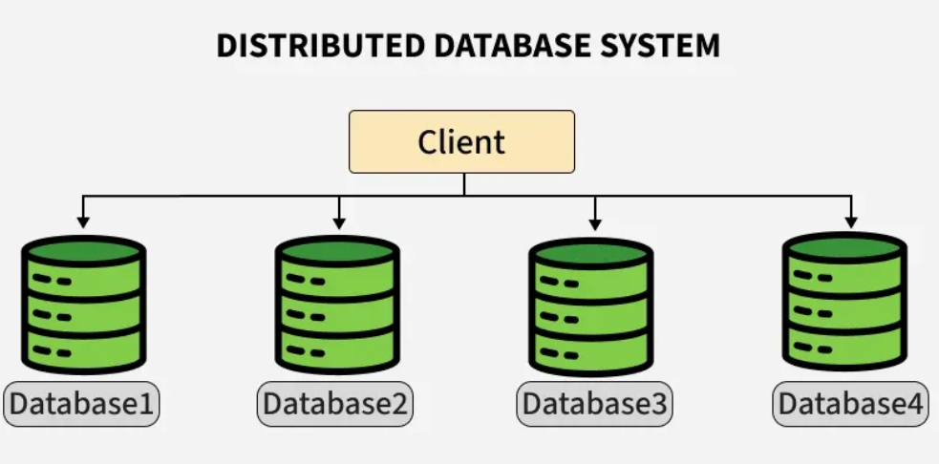
The Birth of NoSQL
The emergence of NoSQL systems did not originate from academic theory, but from real, pressing, large-scale demands.
In the mid-2000s, some of the world’s largest technology organizations faced problems that traditional RDBMS could not efficiently solve.

Slide 21
Google, Amazon, Facebook
Companies such as Google, Amazon, and Facebook managed:
Billions of users
Massive data volumes
Globally distributed infrastructures
Extremely high read and write loads
These requirements exceeded the limits of classical relational databases.

Slide 22
Need for Massive Scalability
The core problem was massive scalability:
Horizontal expansion to hundreds or thousands of nodes
Continuous addition of resources without downtime
Tolerance to node and network failures
Predictable performance at global scale
NoSQL systems were designed from the outset for scale-out.

Slide 23
Commodity Hardware
Another crucial factor was the use of commodity hardware:
Cheap, standard servers
Accepting failure as normal
Shifting complexity from hardware to software
Instead of few powerful servers, NoSQL architectures rely on many simple nodes.
Notes:
A commodity is any useful or valuable thing, especially something that is bought and sold.

Slide 24
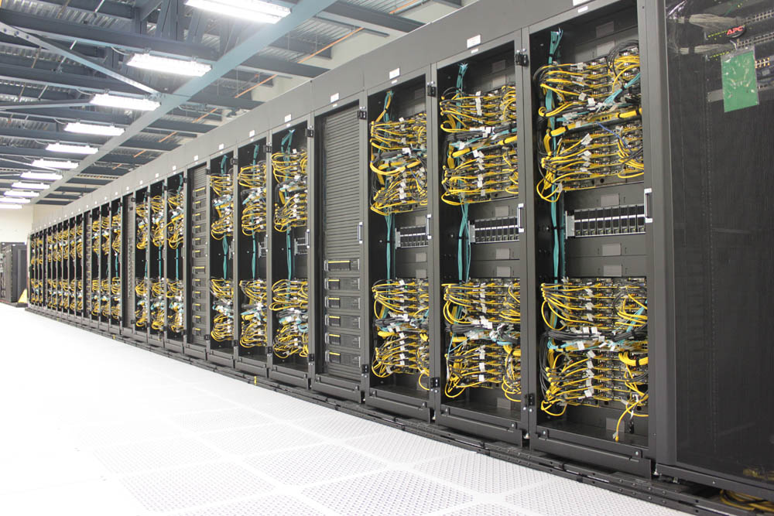
Conclusion
NoSQL systems were born as a response to global-scale requirements.
They were not designed to replace RDBMS entirely, but to address massive scalability, distributed operation, and cost challenges.

Slide 25
What Does NoSQL Mean
The term NoSQL is often misunderstood as rejection of SQL.
In reality, it represents an architectural and philosophical shift driven by large-scale distributed application needs.

Slide 26
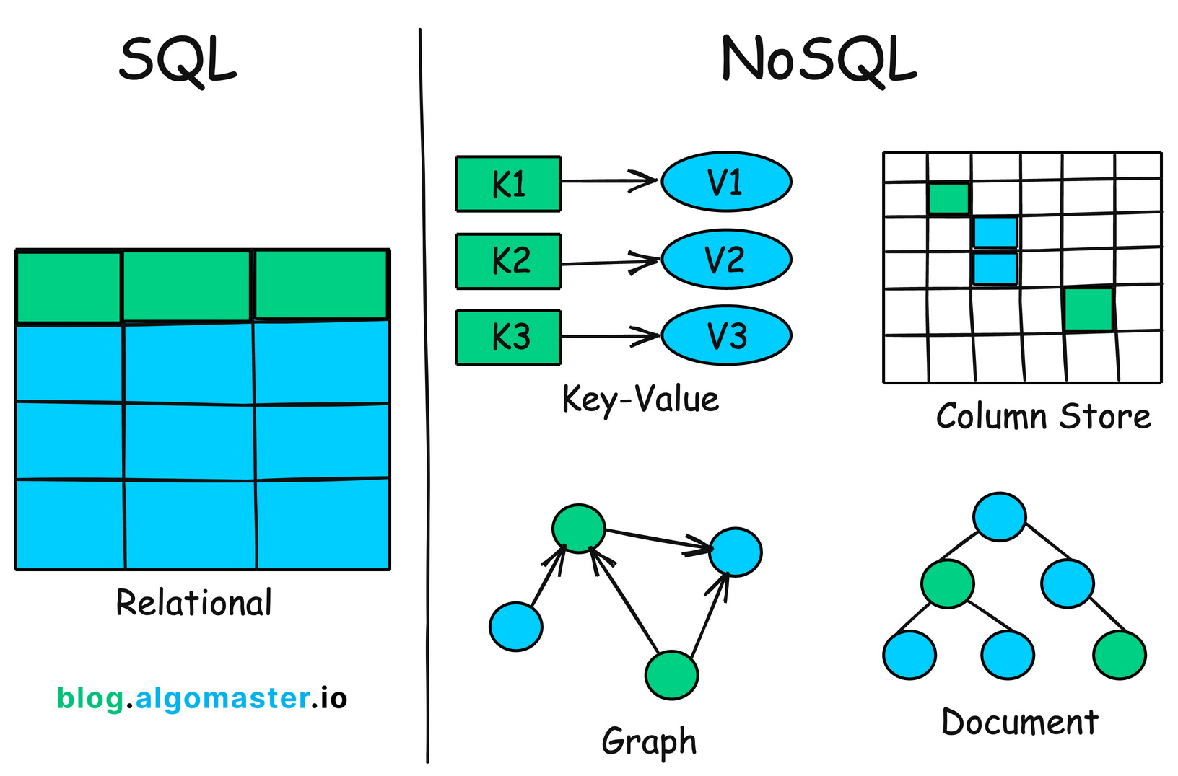
Not Only SQL
NoSQL primarily means “Not Only SQL”:
Not rejection of SQL
Not devaluation of relational databases
Expansion of available data models
Different workloads require different structures and guarantees.

Slide 27
Not Replacement of RDBMS
NoSQL systems:
Were not designed to replace RDBMS
Do not target all use cases
Do not guarantee full ACID in all scenarios
RDBMS remain irreplaceable in:
Transactional systems
Financial applications
Environments requiring strong consistency
Notes:
ACID in databases stands for Atomicity, Consistency, Isolation, and Durability, a set of properties ensuring database transactions are processed reliably, securely, and accurately, even during failures or errors. It guarantees that data remains valid and consistent, making it essential for financial and critical systems.

Slide 28
Complementary Technology
The role of NoSQL is complementary:
Provide massive scalability
Support flexible or schema-less data
Operate efficiently in distributed cloud-native environments
Modern architecture follows polyglot persistence.

Slide 29
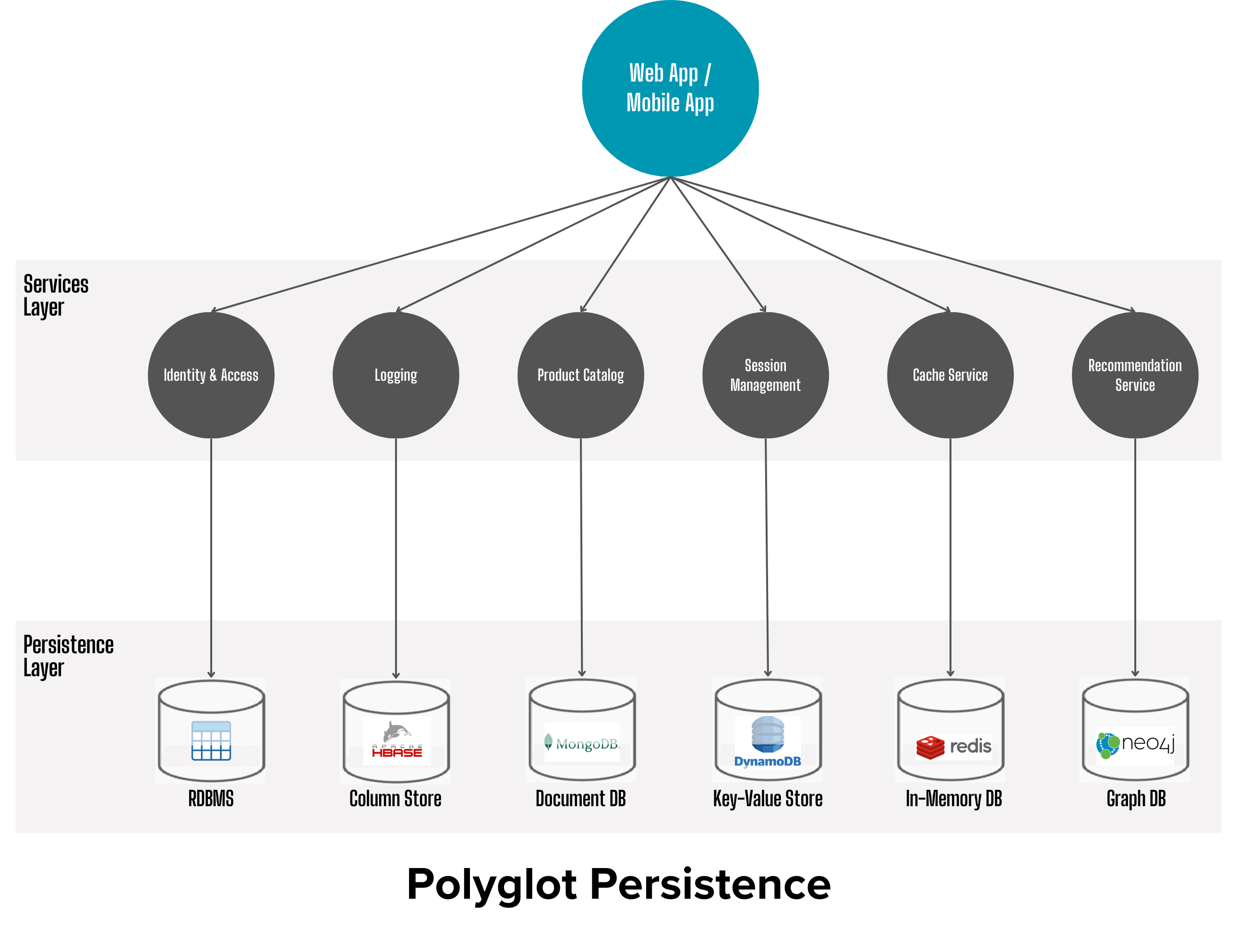
Conclusions
NoSQL is not a revolution against RDBMS, but an evolution of the data ecosystem.
There is no single database model for all problems, but a set of specialized technologies working complementarily.

Slide 31
Core Principles of NoSQL
NoSQL systems are based on fundamentally different design principles, oriented from the outset toward distributed, large-scale, cloud-native environments.

Slide 32
Distributed by Design
NoSQL systems are distributed by nature:
No central node
Operate on multiple equal servers
Assume network and node failures
Distribution is not an afterthought, but a structural characteristic.

Slide 33
Horizontal Scalability
Scaling through scale-out:
Adding nodes without downtime
Sharding
Linear growth in capacity and throughput
Performance increases through parallelism.

Slide 34
High Availability
High availability is a primary objective:
Data replication across nodes
Requests served by healthy replicas
Minimal or zero downtime
NoSQL systems are designed to ensure the service remains available even under fault conditions.

Slide 35
Fault Tolerance
Failure tolerance is built-in:
Node failure does not imply system failure
Automatic redistribution
Self-healing mechanisms
"The system continues to operate, even with reduced performance, until full recovery."

Slide 36
NoSQL - Conclusion
NoSQL systems were designed for a world where:
Failures are expected
Scale is massive
Availability is critical
The principles of distributed by design, horizontal scalability, high availability and fault tolerance constitute the foundation upon which the entire NoSQL ecosystem is built.

Slide 37
Schema Flexibility
One of the defining features of NoSQL systems is schema flexibility.
Unlike traditional RDBMS, where schema is strictly predefined, NoSQL adopts dynamic approaches suited for rapidly changing data environments.

Slide 38
Schema-less
Schema-less does not mean absence of structure, but:
No strictly enforced central schema
Different structures per record
Data stored without predefined format
Structure interpretation often moves to the application.

Slide 39
Schema-on-read
In schema-on-read:
Data are stored as generated
Schema applied at read time
Different applications interpret the same data differently
Especially useful in analytics and Big Data pipelines.

Slide 40
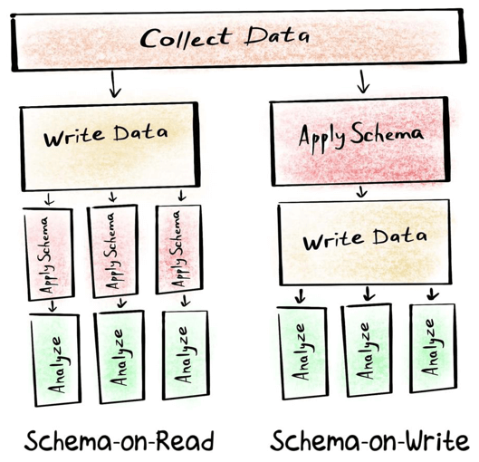
Schema Flexibility

Slide 41
Evolution of Data Models
Schema flexibility allows:
Gradual data evolution without downtime
Easy addition of new fields
Coexistence of old and new versions
Data models evolve with the application, without heavy migrations or database redesign.

Slide 42
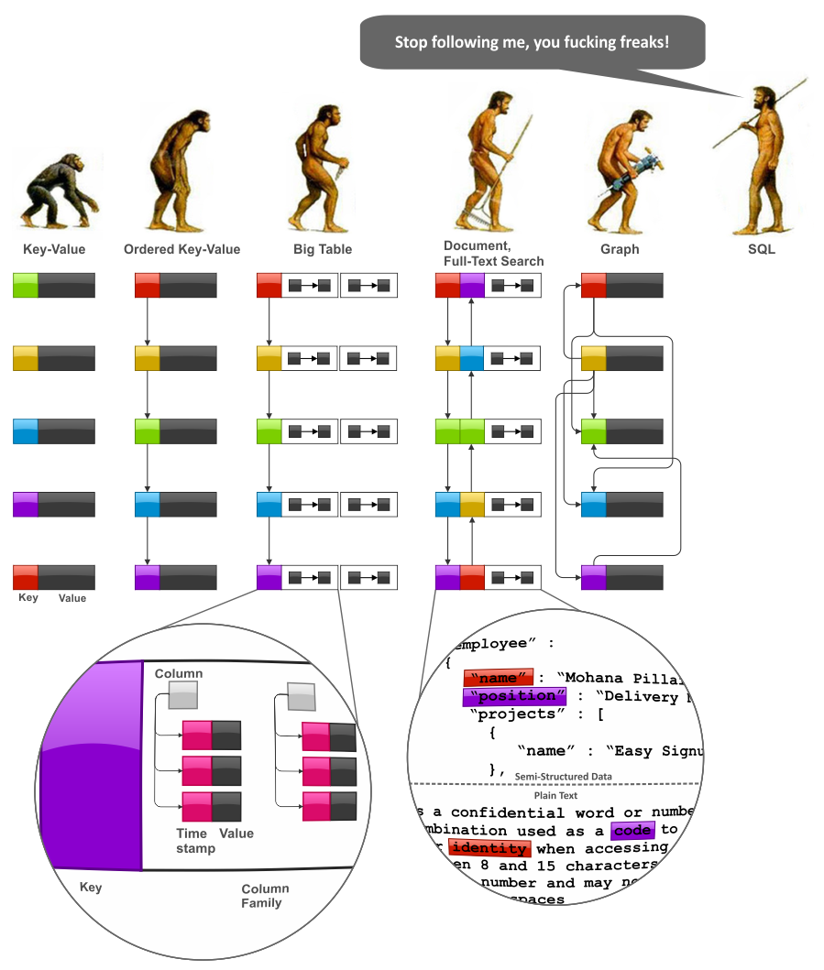

Slide 43
Schema Flexibility - Συμπεράσματα
Schema flexibility in NoSQL systems reflects the reality of modern applications: data changes rapidly and is not always fully known in advance. Schema-less and schema-on-read enable rapid development, experimentation, and adaptability in large-scale, distributed environments.

Slide 44
Denormalization
Denormalization is a central design choice in NoSQL systems. Unlike the relational model, where normalization and joins are a key mechanism, NoSQL systems adopt a different philosophy, oriented towards performance and scalability.

Slide 45
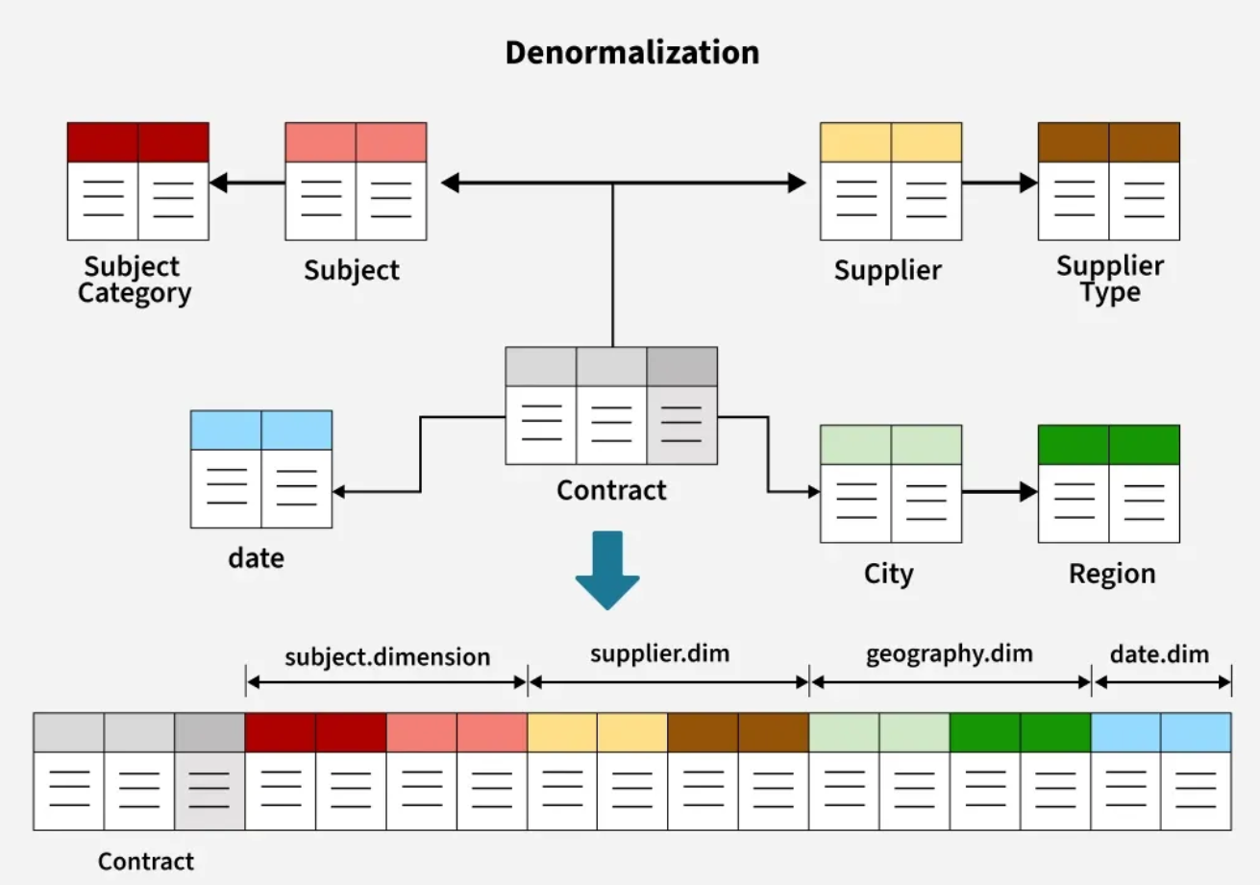

Slide 46
Why Joins Are Avoided
In distributed environments:
Joins require inter-node communication
Cause heavy data transfer
Increase latency
Hinder horizontal scalability
For this reason, NoSQL systems are designed so that a query is served by a single node, without complex read associations.

Slide 47
Denormalization - Replication Δεδομένων
Avoiding joins leads to replication:
Related information stored together
Data repeated intentionally
Each record contains required read information
Repetition is a deliberate design choice.
Repetition is a deliberate design choice.

Slide 48
Trade-off: Storage vs Performance
Denormalization introduces:
Higher storage usage
More complex updates
Much faster reads
Predictable large-scale performance
In Big Data, storage is cheaper than latency.

Slide 49
Denormalization - Conclusion
Denormalization in NoSQL is not a bad practice, but a necessary strategy for distributed systems. Avoiding joins and controlled data replication allows for high performance, simple scaling, and reliable operation at a global scale.

Slide 50
Consistency vs Availability
In distributed data systems, consistency and availability are two fundamental but often conflicting goals. NoSQL systems introduced different consistency models, accepting that it is not always possible to satisfy all properties simultaneously.

Slide 51
Strong Consistency
Guarantees:
Every read returns the latest write
All users see identical state
System behaves like a single centralized database
Trade-off:
Higher latency
Reduced availability during network failures
Notes:
A trade-off is a kind of compromise that involves giving up something in return for getting something else. When looking you for an after-school job, you might have to make a trade-off: a lower hourly wage for a more convenient location, for example.

Slide 52
Eventual Consistency
Accepts that:
Updates are not immediately visible everywhere
Temporary stale reads may occur
Nodes eventually converge
Trade-off:
Higher availability
Lower latency
Requires careful application design

Slide 53
Thank You

